Slide 1
Data Analytics (CS3203N)
Lecture #1
Introduction to Data

Slide 2

Quote of the day..
It is very easy to be a teacher, but very difficult to be a student.
A good student has to learn many concepts, perform in examinations, loyal to his teacher and others.
Quote from Hichcki, a Hindi feature film directed by Siddharth P. Malhotra.

Slide 3
In today’s discussion…
Introduction to data
Current trend
Data and Big data
Big data vs. small data
Tools and techniques

Slide 4
Data analytics – process of analyzing raw data to get insights and find patterns about the information. Using various techniques and processes the raw data is transformed into a format which could be further visualized and be made human readable.
Descriptive analytics , the process of describing historical trends in data and
aims to answer what happened which involves measuring traditional indicators such as return of investment , indicators used will be different for each industry , DA does not make predictions nor directly informed decisions, it focuses on summarizing data in a meaningful and descriptive way
Advanced analytics, takes advantage of advanced tools to extract data, make predictions and discover trends , these tools include classical statistics as well as machine learning tasks such as neural networks, natural language processing sentiment analysis and more.

Slide 5
EXAMPLE OF DATA ANALYTICS
Wayne who is a digital marketing professional is running an online promotional campaign to promote a new Smart tv. He starts targeting a group of people who might have bought the previous versions of Smart tv. As the campaign runs, Data analytics come into the picture to screen through the data generated whenever people clicked on the published advertisement. By inspecting the data about these users’ interests and their buying patterns you might come across that many of these are interested in streaming 4K UHD video. Using these information you can tune in your ads to focus on users who have bought the previous version of Smart tv and interested on 4K Smart tv. These data can also be used to attract new customers who did not go for the previous version of Smart tv.

Slide 6
Why is data analytics significant?
Businesses use data analytics to optimize and grow by making better business decisions and finding more efficient ways of doing business. The company can build new and better products with the buying patterns and will have better understanding of what the customers need
The pursuit of extracting meaning from raw data using specialized computer systems and this is converting raw data into something with meaningful information
These systems transform, organize, and model the data to draw conclusions and identify patterns

Slide 7
How data analytics work
Data analytics has several processes and variety of initiatives and by combining these components a data analytics initiative will provide a clear picture of
Where you are
Where you have been
Where you should go
Generally, this process begins with descriptive analytics.This information provides new insights from data
Advanced analytics addresses
What if
Data analytics affects every aspects of our day to day life

Slide 8
Everyday applications of data analytics
Social media stats instantly register anytime there’s a visitor or a post to a page
Cell phone bills can pull up months of calling data to show you patterns of usage
Sensors monitor the changing weather and report that data to you instantly on your phone
Sports fans collect statistics on their favorite athletes and often use the data to form teams for fantasy leagues
Schools across the nation are involved in high stakes testing that generates voluminous data on each students progress
Data analytics is a growing field and will always be a top domain to get into
A data analyst in the U.S. is receiving $70,000 per annum
There are 27,000 data analytics jobs available in Linkdn and a few number of professionals to fill that gap

Slide 9
A Categorization of Analytical Methods and Models
Descriptive Analytics:
Descriptive analytics: Encompasses the set of techniques that describes what has happened in the past; examples include:
Data queries.
Reports.
Descriptive statistics.
Data visualization (including data dashboards).
Data-mining techniques.
Basic what-if spreadsheet models.
Data query: A request for information with certain characteristics from a database.

Slide 10
Descriptive Analytics (cont.):
Data dashboards: Collections of tables, charts, maps, and summary statistics that are updated as new data become available.
Uses of dashboards:
To help management monitor specific aspects of the company’s performance related to their decision-making responsibilities.
For corporate-level managers, daily data dashboards might summarize sales by region, current inventory levels, and other company-wide metrics.
Front-line managers may view dashboards that contain metrics related to staffing levels, local inventory levels, and short-term sales forecasts.

Slide 11
Descriptive Analytics (cont.):
Data mining: The use of analytical techniques for better understanding patterns and relationships that exist in large data sets.
Examples of data-mining techniques include:
Cluster analysis.
Sentiment analysis.

Slide 12
Predictive Analytics:
Predictive analytics: Consists of techniques that use models constructed from past data to predict the future or ascertain the impact of one variable on another.
Survey data and past purchase behavior may be used to help predict the market share of a new product.

Slide 13
Predictive Analytics (cont.):
Techniques used in Predictive Analytics include:
Linear regression.
Time series analysis.
Data mining is used to find patterns or relationships among elements of the data in a large database; often used in predictive analytics.
Simulation involves the use of probability and statistics to construct a computer model to study the impact of uncertainty on a decision.
Notes:
Example for Data Mining:
A large grocery store chain might be interested in developing a new targeted marketing campaign that offers a discount coupon on potato chips.
By studying historical point-of-sale data, the store may be able to use data mining to predict which customers are the most likely to respond to an offer on discounted chips by purchasing higher-margin items such as beer or soft drinks in addition to the chips, thus increasing the store’s overall revenue.
Example for Simulation:
Banks often use simulation to model investment and default risk in order to stress-test financial models.
Used in the pharmaceutical industry to assess the risk of introducing a new drug.

Slide 14
Prescriptive Analytics:
Prescriptive Analytics: Indicates a best course of action to take:
Provide a forecast or prediction, but do not provide a decision.
A forecast or prediction, when combined with a rule, becomes a prescriptive model.
Prescriptive models that rely on a rule or set of rules are often referred to as rule-based models.

Slide 15
Prescriptive Analytics (cont.):
Model | Field | Purpose
Portfolio models | Finance | Use historical investment return data to determine the mix of investments that yield the highest expected return while controlling or limiting exposure to risk.
Supply network design models | Operations | Provide the cost-minimizing plant and distribution center locations subject to meeting the customer service requirements.
Price-markdown models | Retailing | Use historical data to yield revenue-maximizing discount levels and the timing of discount offers when goods have not sold as planned.
Optimization models: Models that give the best decision subject to constraints of the situation.

Slide 16
Prescriptive Analytics (cont.):
Simulation optimization: Combines the use of probability and statistics to model uncertainty with optimization techniques to find good decisions in highly complex and highly uncertain settings.
Decision analysis:
Used to develop an optimal strategy when a decision maker is faced with several decision alternatives and an uncertain set of future events.
Employs utility theory, which assigns values to outcomes based on the decision maker’s attitude toward risk, loss, and other factors.

Slide 17
Introduction to data
Example:
10, 25, …, Stefani Joanne Angelina Germanotta., CS3202N, psa@gov.ph, March 20, 05887, Jeff Bezos, etc.
Anything else?
Data vs. Information
100.0, 0.0, 250.0, 150.0, 220.0, 300.0, 110.0
Mark Zuckerberg, Michael Dell, Bill Gates
Is there any information?

Slide 18
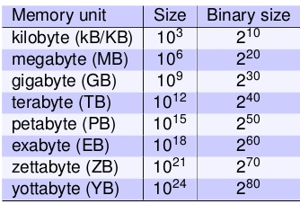
How large your data is?
What is the maximum file size you have dealt so far?
Movies/files/streaming video that you have used?
What is the maximum download speed you get?
To retrieve data stored in distant locations?
How fast your computation is?
How much time to just transfer from you, process and get result?

Slide 19
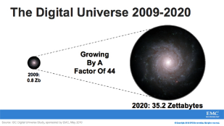

Growth of data

Slide 20
Sources of data
“Every day, we create 2.5 quintillion bytes of data
So much that 90% of the data in the world today has been created in the last two years alone.
The data come from several sources
sensors used to gather climate information
posts to social media sites,
digital pictures and videos
purchase transaction records
cell phone GPS signals
etc. …… to name a few!

Slide 21
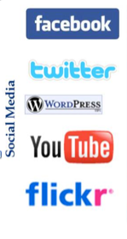
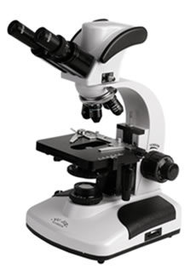
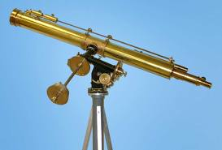
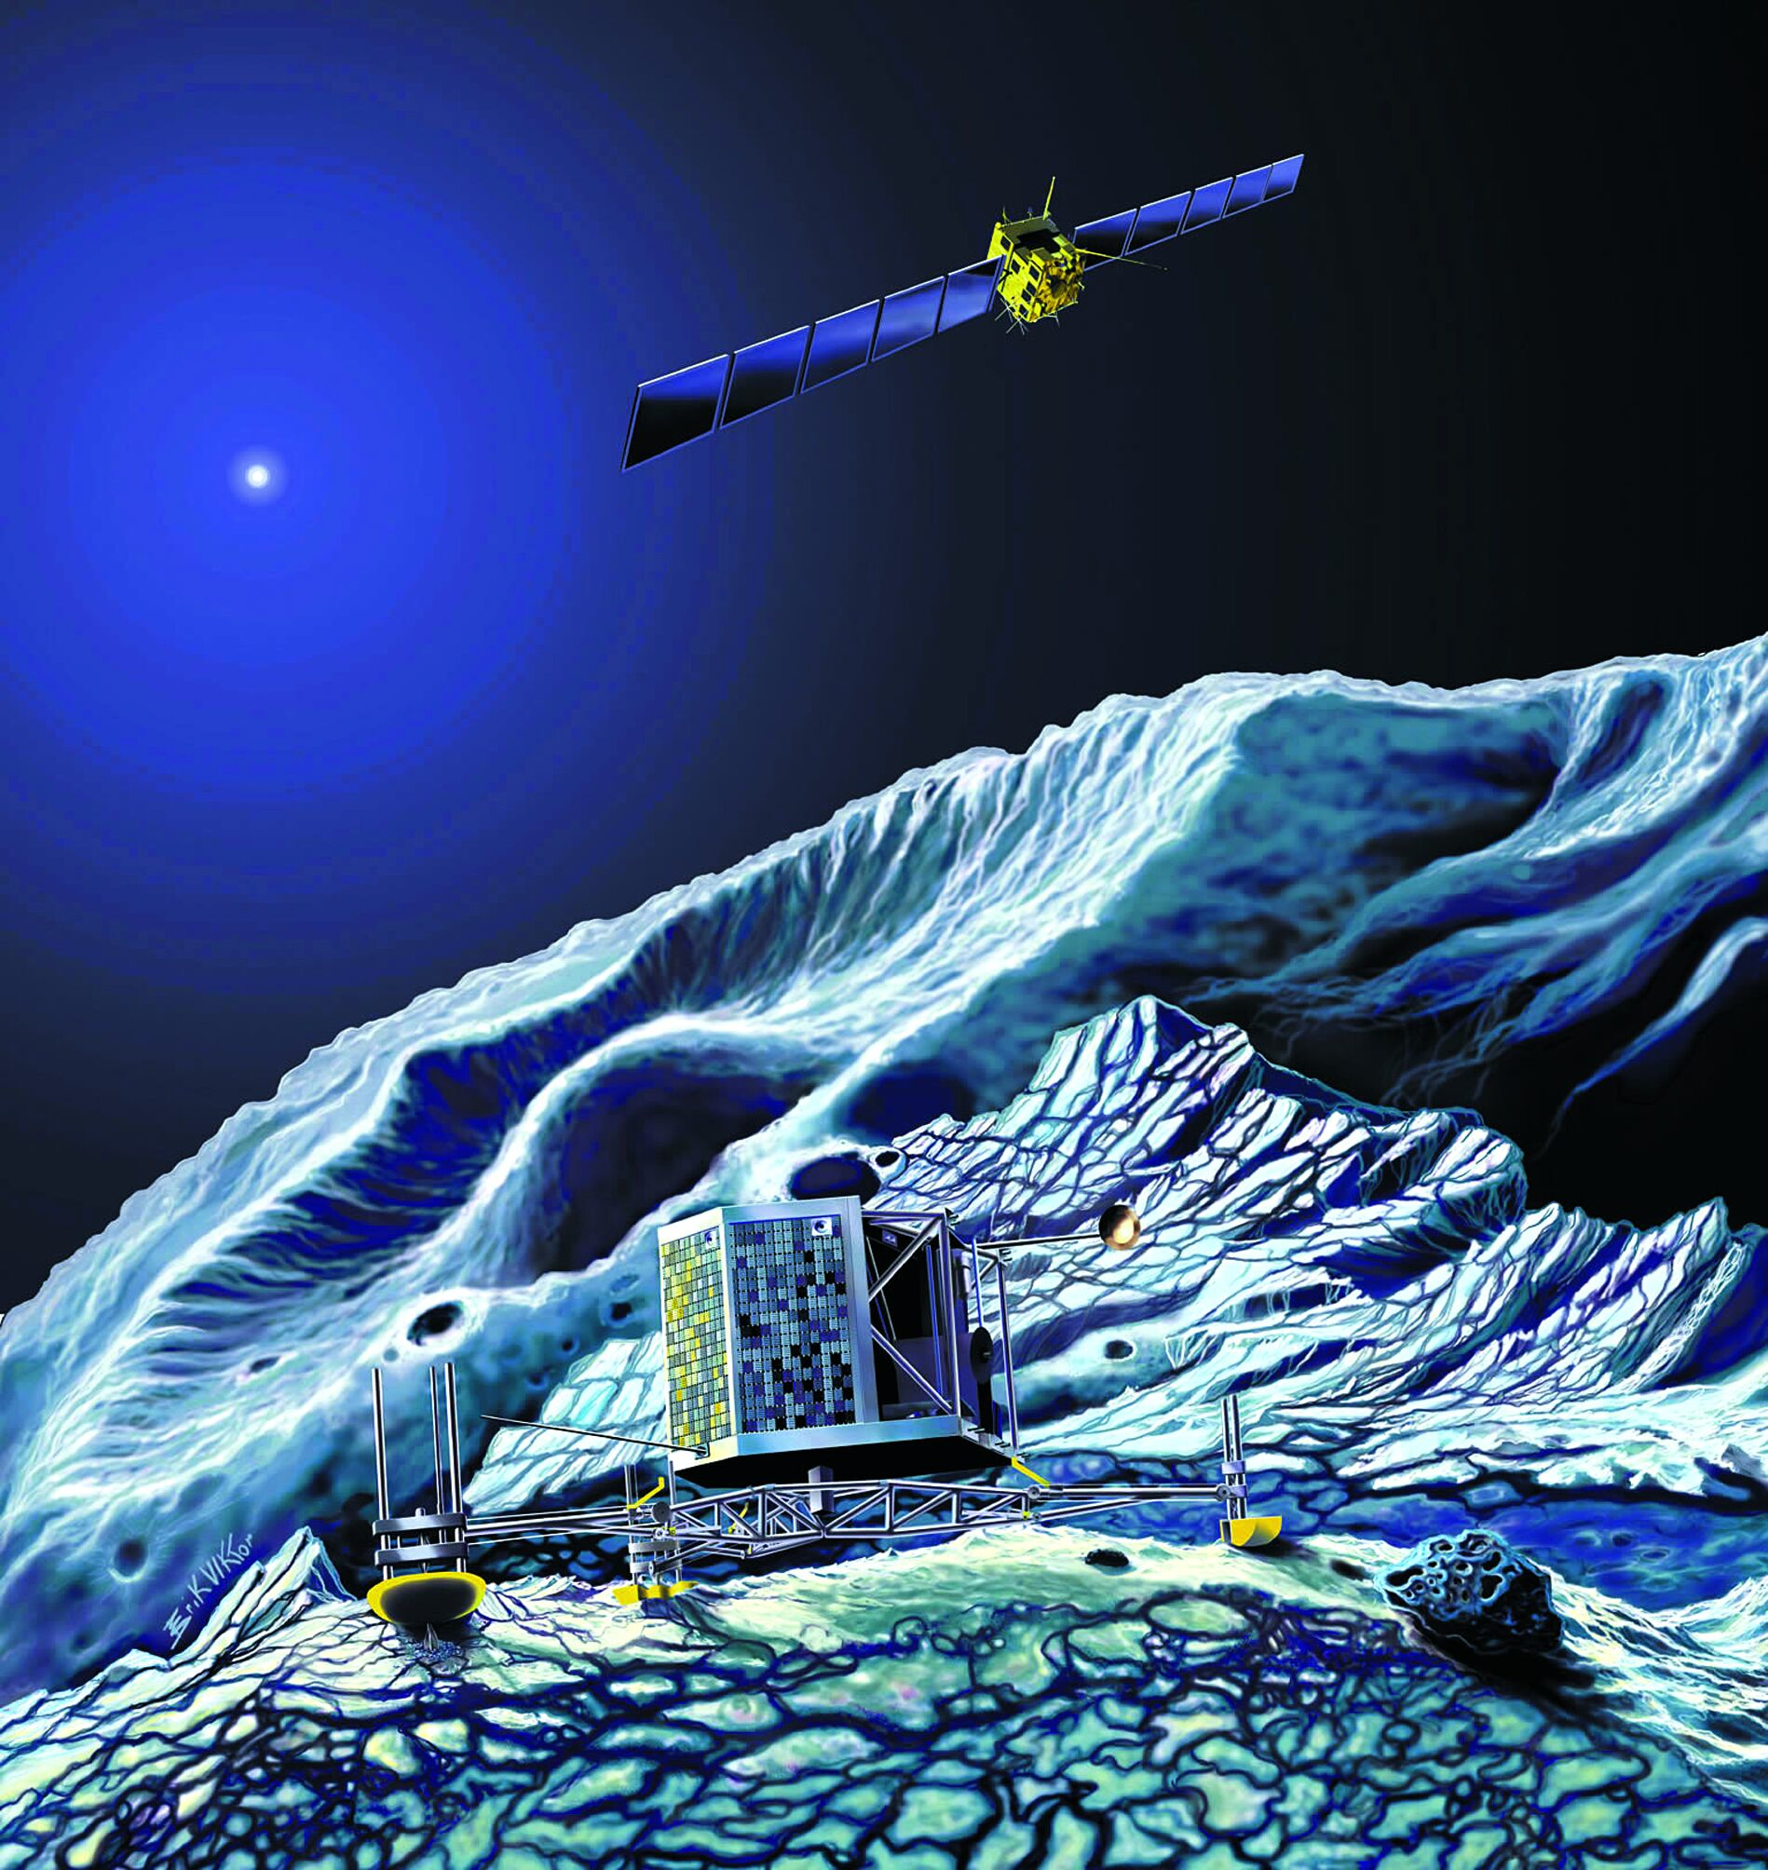
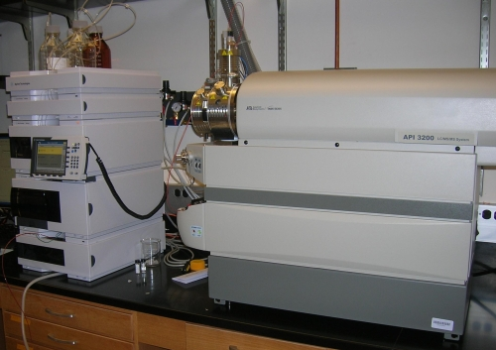
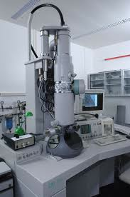

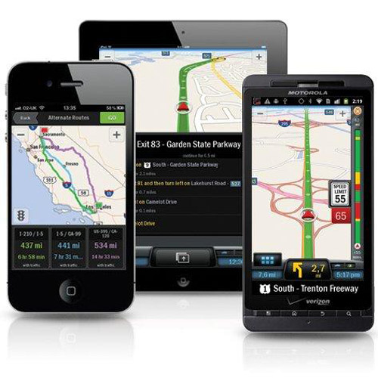
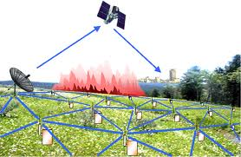
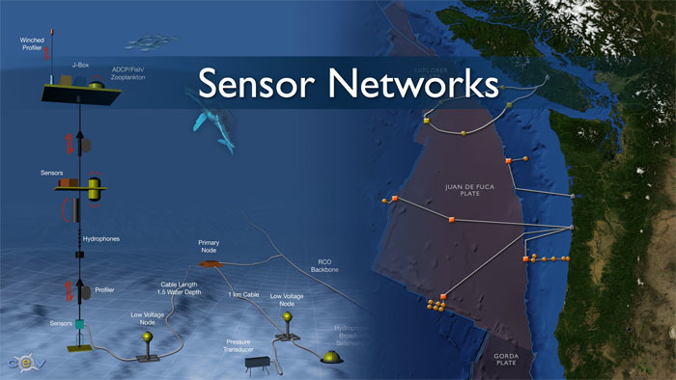
Examples
Social media and networks
(All of us are generating data)
Scientific instruments
(Collecting all sorts of data)
Sensor technology and networks
(Measuring all kinds of data)
Mobile devices
(Tracking all objects all the time)

Slide 22
Now data is Big data!
No single standard definition!
‘Big-data’ is similar to ‘Small-data’, but bigger
…but having data bigger consequently requires different approaches
techniques, tools and architectures
…to solve: new problems
…and, of course, in a better way
Big data is data whose scale, diversity, and complexity require new architecture, techniques, algorithms, and analytics to manage it and extract value and hidden knowledge from it…

Slide 23
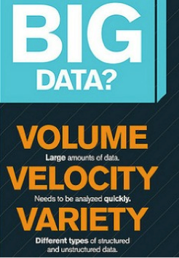
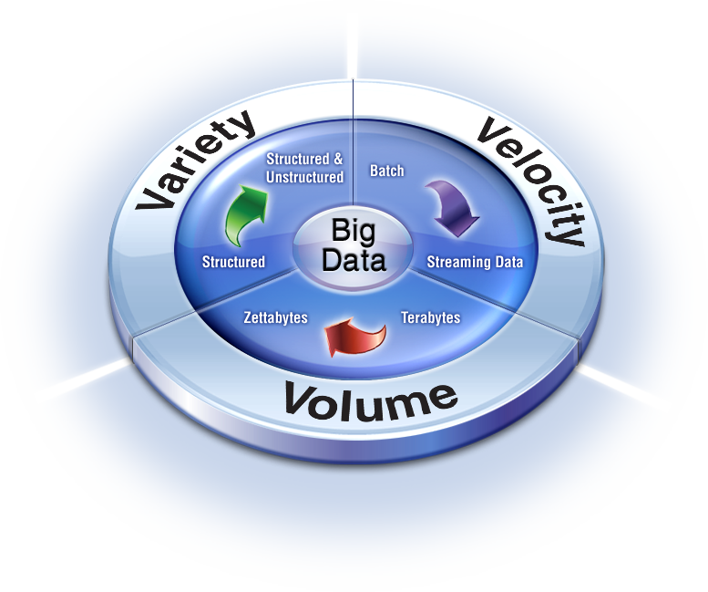
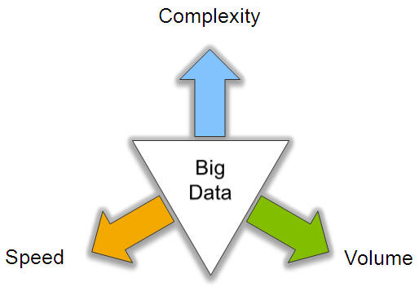
Characteristics of Big data: V3

Slide 24
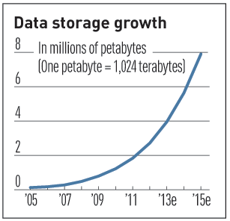
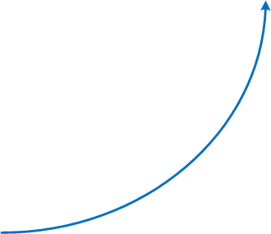
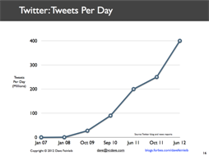
V3 : V for Volume
Volume of data, which needs to be processed is increasing rapidly
More storage capacity
More computation
More tools and techniques

Slide 25
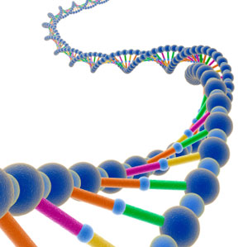
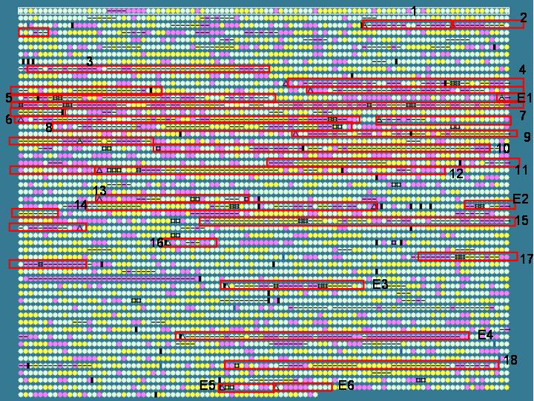
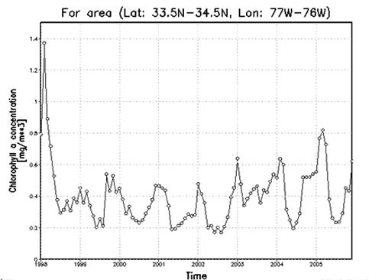

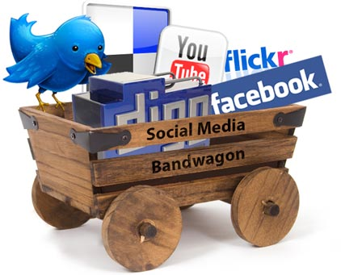
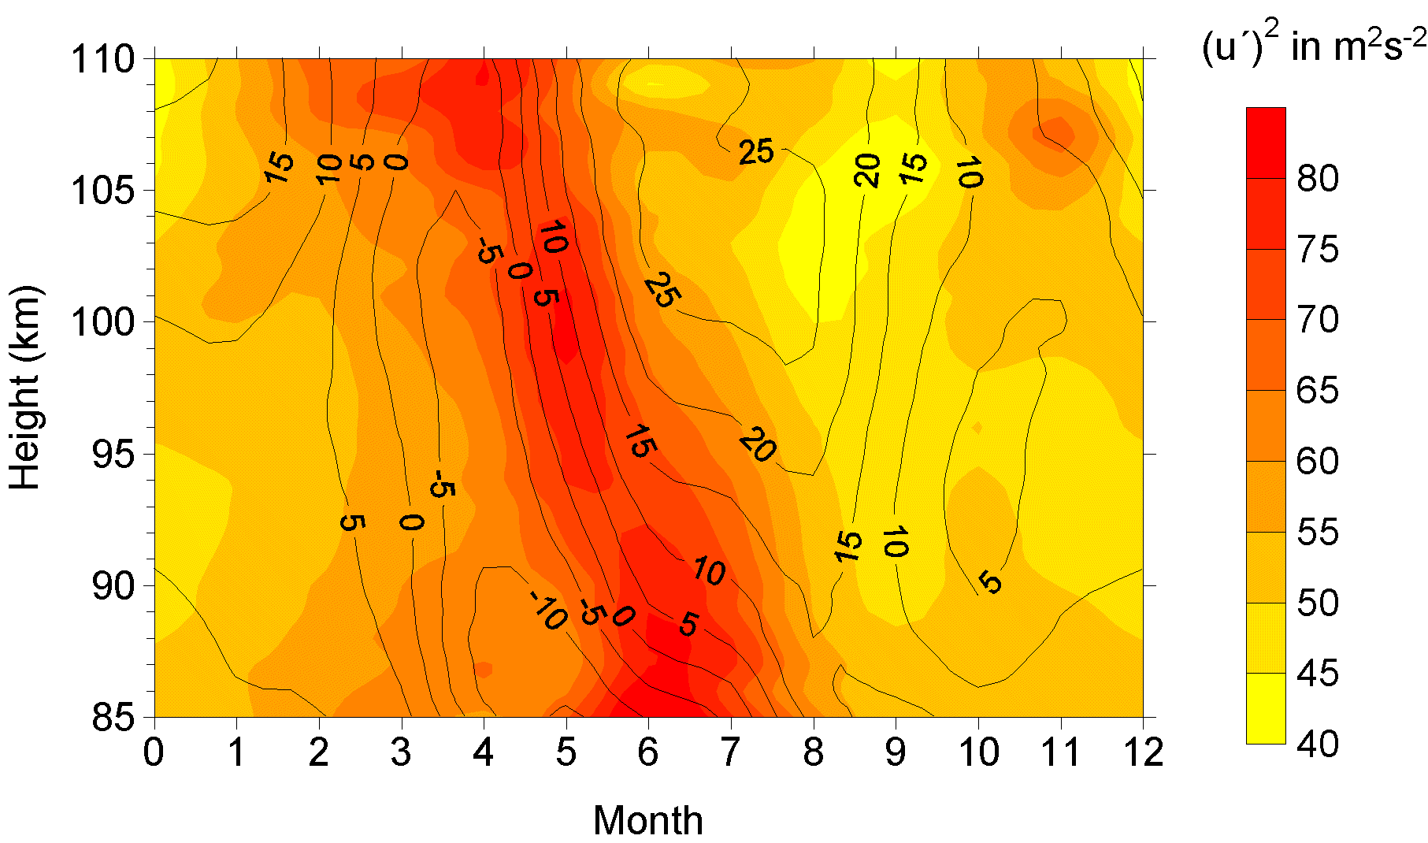
V3: V for Variety
Various formats, types, and structures
Text, numerical, images, audio, video, sequences, time series, social media data, multi-dimensional arrays, etc…
Static data vs. streaming data
A single application can be generating/collecting many types of data
To extract knowledge➔ all these types of data need to be linked together

Slide 26
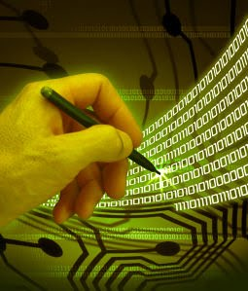
V3: V for Velocity
Data is being generated fast and need to be processed fast
For time-sensitive processes such as catching fraud, big data must be used as it streams into your enterprise in order to maximize its value
Scrutinize 5 million trade events created each day to identify potential fraud
Analyze 500 million daily call detail records in real-time to predict customer churn faster
Sometimes, 2 minutes is too late!
The latest we have heard is 10 ns (nano seconds) delay is too much

Slide 27
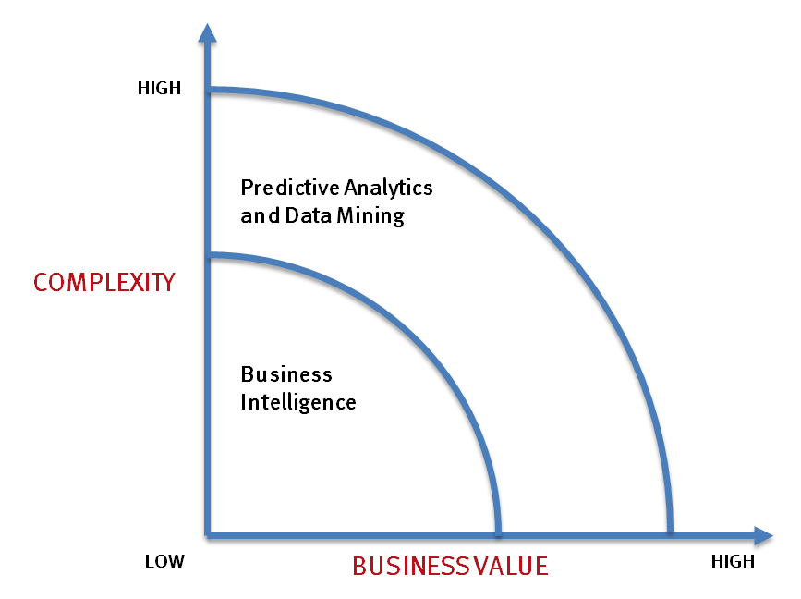
Big data vs. small data
- Optimizations and predictive analytics
- Complex statistical analysis
- All types of data, and many sources
- Very large datasets
- More of a real-time
- Ad-hoc querying and reporting
- Data mining techniques
- Structured data, typical sources
- Small to mid-size datasets

Slide 28
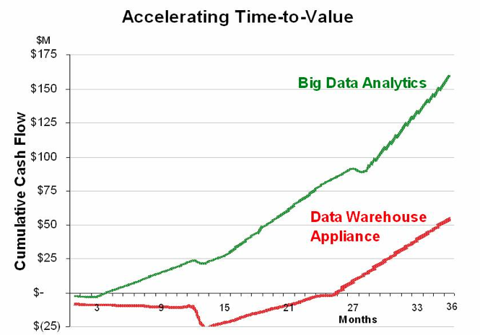
Big data vs. small data
Big data is more real-time in nature than traditional applications
Big data architecture
Traditional architectures are not well-suited for big data applications (e.g. Exa-data, Tera-data)
Massively parallel processing, scale out architectures are well-suited for big data applications

Slide 29
Challenges ahead…
The Bottleneck is in technology
New architecture, algorithms, techniques are needed
Also in technical skills
Experts in using the new technology and dealing with Big data
Who are the major players in the world of Big data?

Slide 30
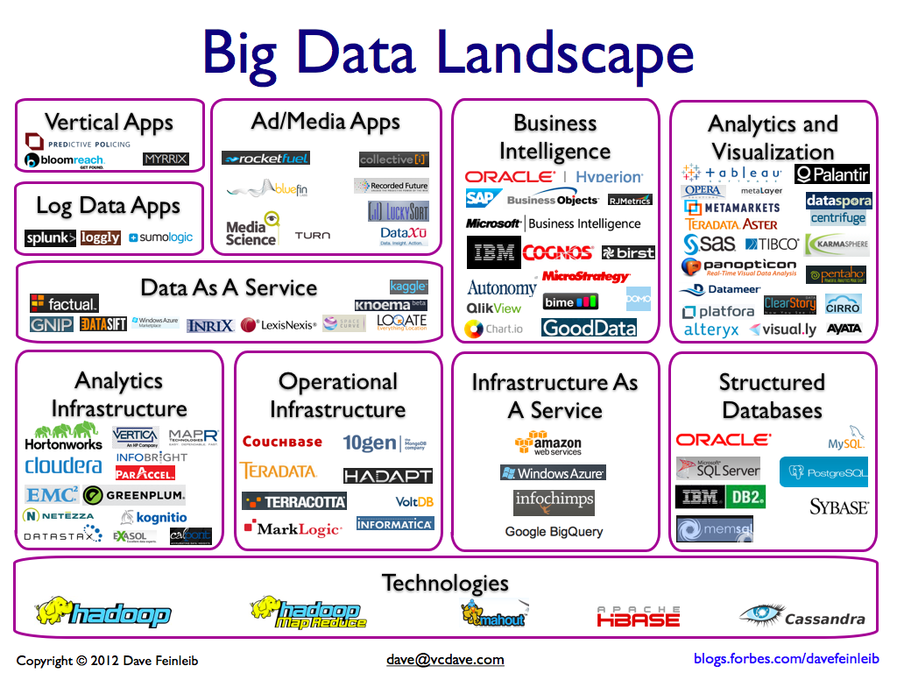
Big data players

Slide 31






Major players…
Google
Hadoop
MapReduce
Mahout
Apache Hbase
Cassandra

Slide 32
Tools available
NoSQL
DatabasesMongoDB, CouchDB, Cassandra, Redis, BigTable, Hbase, Hypertable, Voldemort, Riak, ZooKeeper
MapReduce
Hadoop, Hive, Pig, Cascading, Cascalog, mrjob, Caffeine, S4, MapR, Acunu, Flume, Kafka, Azkaban, Oozie, Greenplum
Storage
S3, HDFS, GDFS
Servers
EC2, Google App Engine, Elastic, Beanstalk, Heroku
Processing
R, Yahoo! Pipes, Mechanical Turk, Solr/Lucene, ElasticSearch, Datameer, BigSheets, Tinkerpop

Slide 33
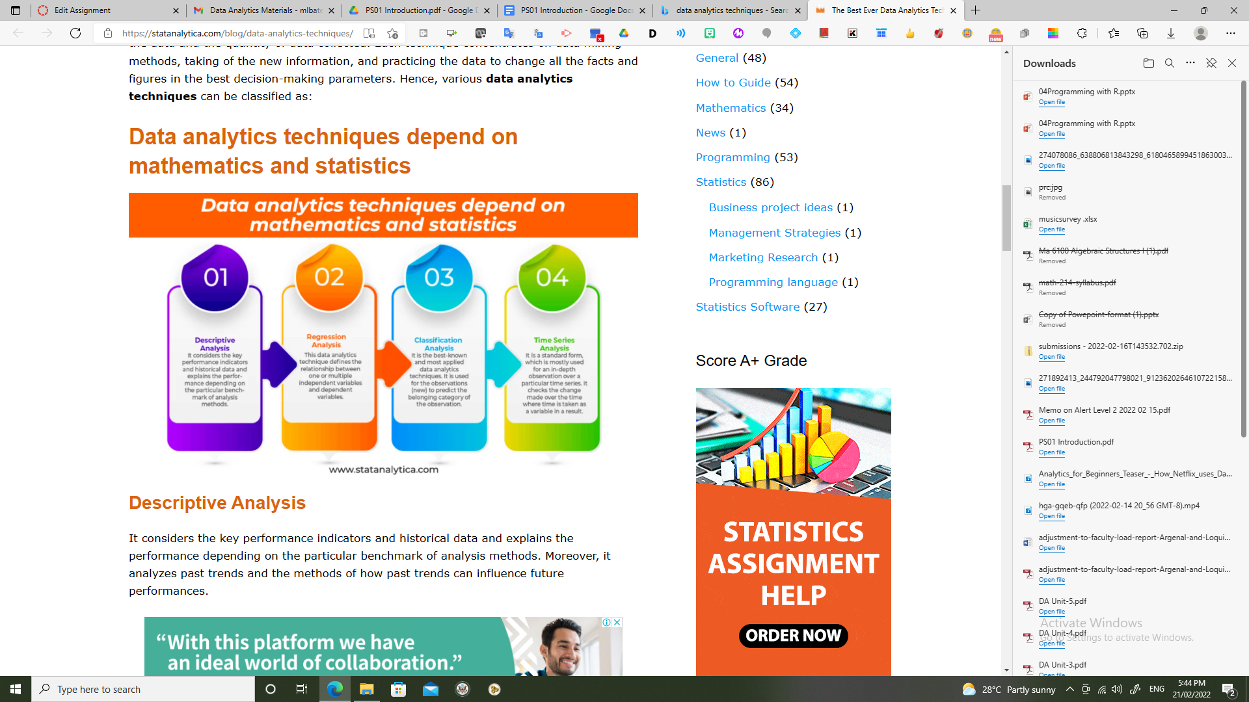

Slide 34
Descriptive Analysis
It considers the key performance indicators and historical data and explains the performance depending on the particular benchmark of analysis methods. Moreover, it analyzes past trends and the methods of how past trends can influence future performances.
For example, an insurance company collects its customer’s data to know various traits, such as customer’s age, agender, and nationality. The descriptive analysis helps the insurance company to get a better profile of each customer. Calculation of frequency helps in identifying the numbers of customers under a specific age; calculation of central tendency helps in identifying who the most customer are. More calculation of dispersion helps in identifying the variations, such as customer’s age; finally, the calculation of position helps in comparing customer’s segments depend on various traits.

Slide 35
Regression Analysis
This data analytics technique defines the relationship between one or multiple independent variables and dependent variables. The regressions model could be multiple, ridge, life data, linear, logistic, non-linear, or other.
For example: Assume you have a business of lemonade. You can use simple linear regression for determining the relationship between the temperature and revenue, with the help of sample size for revenue by considering it as a dependent variable. You can also determine the relationship between pricing, temperature, and workers’ numbers to the revenue in multiple variable regression. Hence, regressions analysis can help in analyzing the impact of varied parameters on business profits and sales.

Slide 36
Classification Analysis
It is the best-known and most applied data analytics techniques. It is used for the observations (new) to predict the belonging category of the observation. Classification is made with the help of analysis of historical observations of a known category. Several models use for classification, and one of the best and known model is a decision tree. The decision tree is the process that is used for answering yes or no questions to examine the category of the observation. This analysis technique is mostly used in combination along with the logistic regression that can easily enhance the prediction performance of the statistical model.
For example: In the healthcare sector, classification analysis is used to examine a new patient’s symptoms with the help of numerous patients’ historical data. The “classification” data analytics techniques are already utilized to predict cancer and discovering the high-risk groups.

Slide 37
Time Series Analysis
It is a standard form, which is mostly used for an in-depth observation over a particular time series. It checks the change made over the time where time is taken as a variable in a result. Here, you have to keep in mind that time is not a single parameter that is included in a measurement, but it is one of the primary axes on which the data is observed. There is a difference between another analysis and time series analysis, and that is the observation, or the data is gathered over a particular interval of time. It helps in identifying systemic trends, seasonal variances, and cycles of the observed data.
For example, A sales team of an organization analyzed an updated dashboard and observed that their predicted sales for the forthcoming game were much lower than normal. Approximately a week before the launch of the game, the team made a strategy to increase the sale of the ticket. The team developed a marketing strategy few days before the launch. Here they used time series analysis and created a promotional ticket offer on Father’s Day to increase the sales of the game. This helped them a lot in the increment of the game’s sale.

Slide 39
Bar Chart, Column Chart | Both charts are useful for giving numerical differences among categories.
Word Cloud Chart | It is used as the visual representation of text data. This chart needs a large data and the discrimination’s degree.
Line Chart | It represents the transformation of data across a continuous time interval.
Gantt Chart | It gives the exact timing and the activity’s progress in contrast to the requirements.
Area Chart | It is used to fill the area between the axis and the polyline with color to represent better trend data.
Radar Chart | It describes which data variable has higher values and which has the lower values. Moreover, it uses to compare various quantized charts.
Pie Chart | It represents the proportion of various groups. It is mostly used for only one data series.
Scatter Plot | It presents the variable distribution in points to reveal the correlation among the rectangular coordinate system variables.
Funnel Chart | It is used to represent the proportion of individual stages and reflects the individual module’s size. It also supports ranking comparison.
Bubble Chart | It is a scatter plot’s variation. Here, the bubble area can be represented as the 3rd value.

Slide 41
Artificial Neural Networks | It is a system that can improve its structure depending on the information that flows within the network. It considers being highly dependable in forecasting applications and business classification.
Decision Trees | A tree-shaped model that describes a regression or classification model. It distributes the data sets into smaller subsets and develops in a similar decision tree simultaneously.
Evolutionary Programming | It is domain-independent data analytics techniques that use to examine extensive search space efficiently.
Fuzzy Logic | Another data analysis technique depends on the probability that helps in handling the difficulties in data mining techniques.

Slide 42
Questions of the day…
What is the smallest and largest units of measuring size of data?
How big a Quintillion measure is?
Give FIVE parameters with which data can be categorized as i) simple, ii) Moderately complex and iii) complex?

Slide 43
Questions of the day…
4. What type of data are involved in the following applications?
Weather forecasting
Mobile usage of all customers of a service provider
Anomaly (e.g. fraud) detection in a bank organization
Person categorization, that is, identifying a human
Air traffic control in an airport
Streaming data from all flying aircrafts of Boeing

